Slide 1












Introduction to GitHub Actions
Kathi Kellenberger
She/her
Customer Success Engineer
Redgate Software

Slide 2
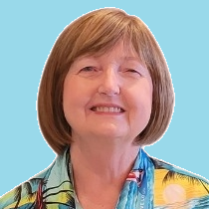


Kathi
Kellenberger
He/Him
Customer Success Engineer
I’ve worked with SQL Server for 25 years as a developer, DBA, and now at Redgate. I’m a former Data Platform MVP and love to present and write about SQL Server. You can find my work on Amazon and Pluralsight.
Redgate Software
Kathi.Kellenberger@red-gate.com
Linkedin.com/in/kathikellenberger

Slide 3
GitHub Actions Components
Workflows
Actions
Variables and secrets
Triggers
Runners
Environments

Slide 4
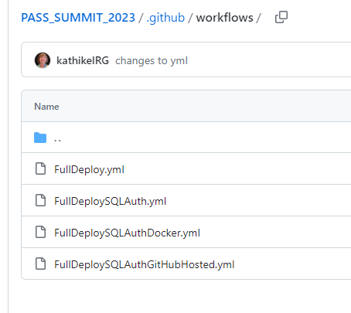
Workflows: Files

Slide 5
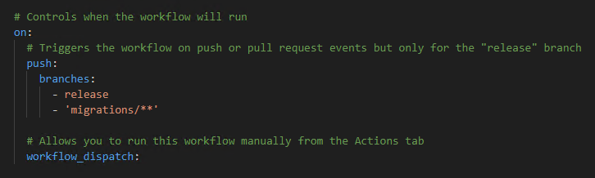
Workflows: Sections

Slide 6
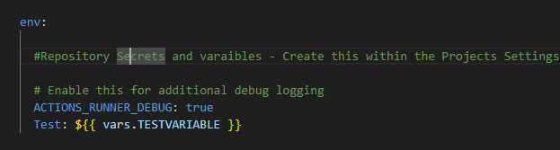
Workflows: Sections

Slide 7
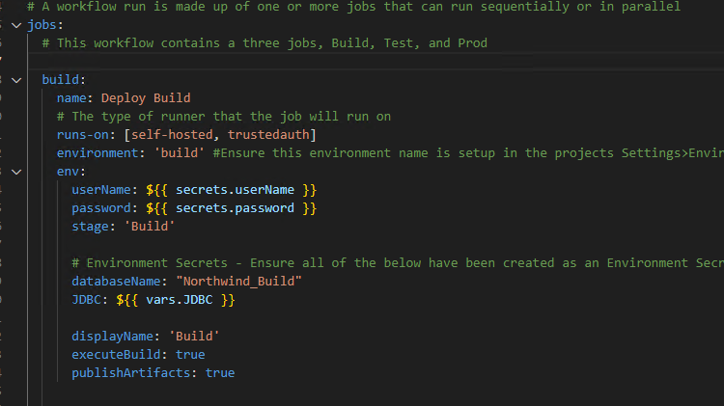
Workflows: Sections

Slide 8
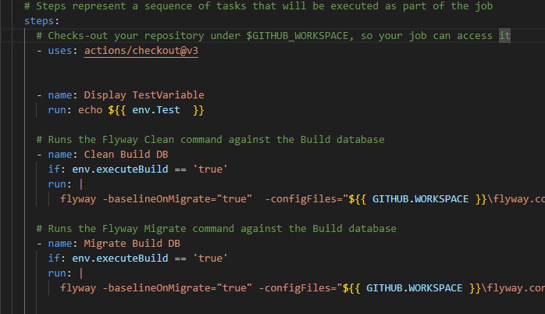
Workflows: Sections

Slide 9
Triggers

Slide 10
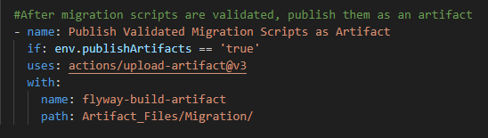
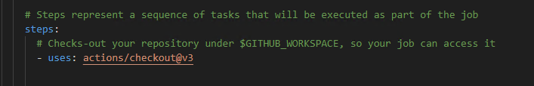
Actions

Slide 11
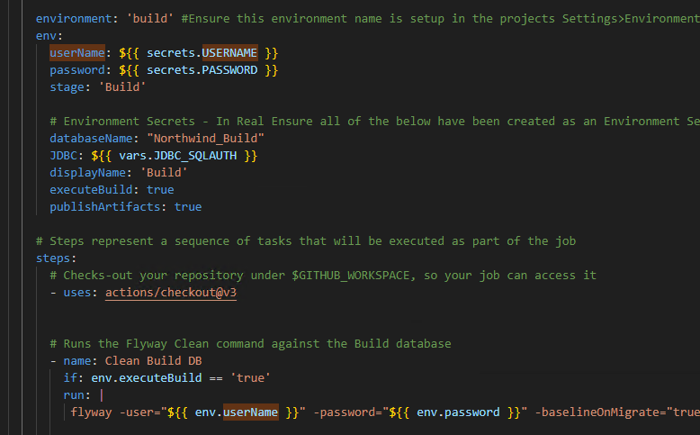
Variable and secrets

Slide 12
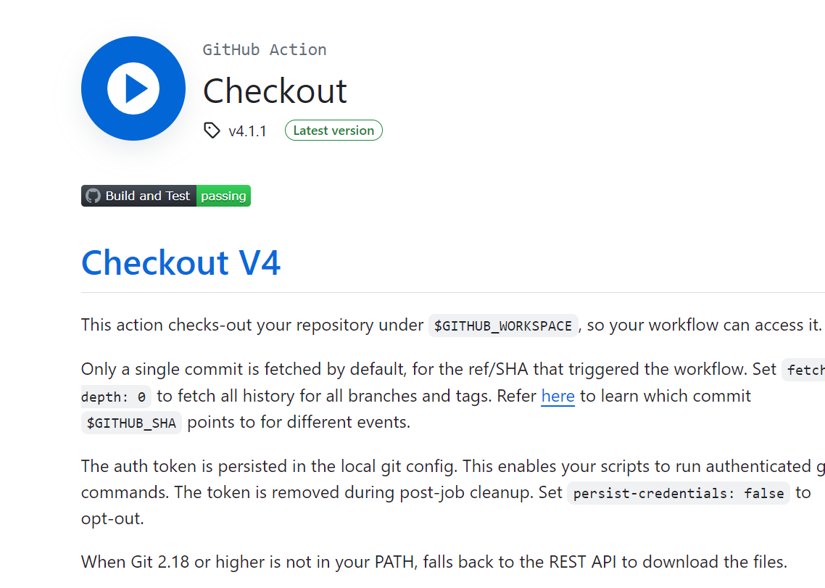
Actions

Slide 13
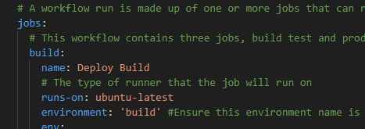
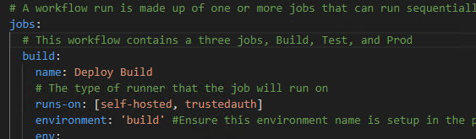
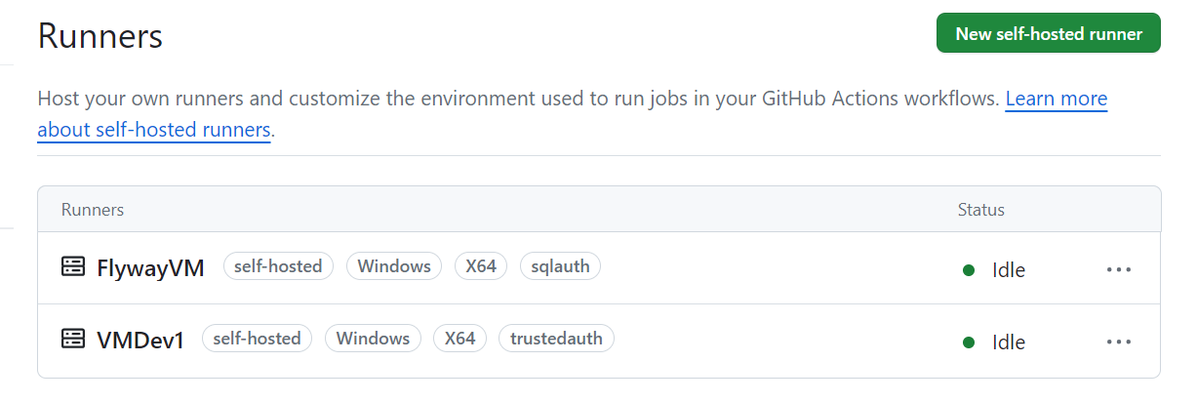
Runners

Slide 14
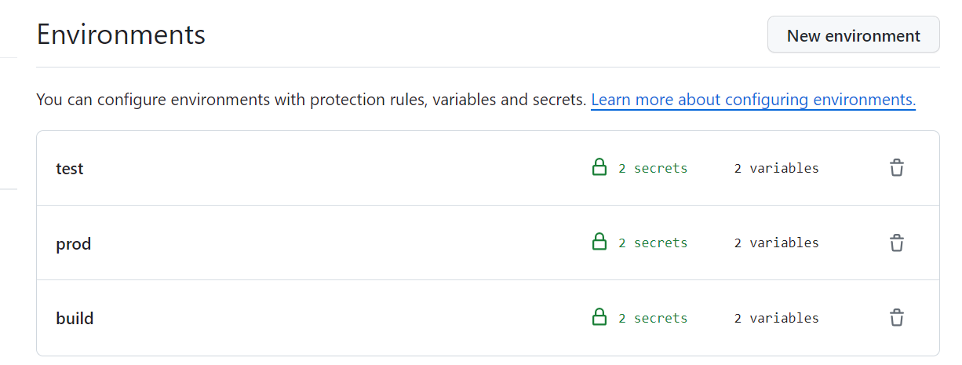
Environments

Slide 15
Resources
https://github.com/kathikelRG/PASS_SUMMIT_2023
Building JDBC connection string
Udemy GitHub Actions course
Udemy YAML course
Reusable workflows
GitHub Actions Marketplace

Slide 16


Slide 17
Kathi Kellenberger
Kathi.Kellenberger@red-gate.com
Linkedin.com/in/kathikellenberger

